Slide 1
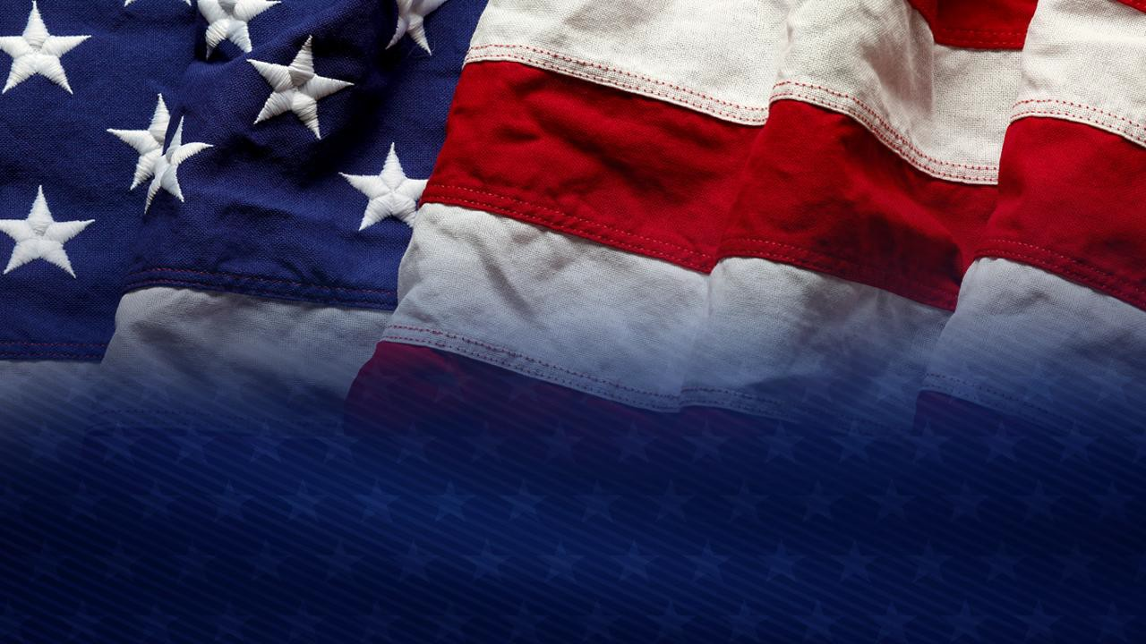
The American Military vs. Radical Indoctrination
By Ronald J. Scott, Jr., Ph.D., Colonel, USAF (ret) STARRS President & CEO
Senator (ret) Michael T. Rose, JD/MBA STARRS Executive Vice President & General Counsel
Delivered by Steven R. Michaels, CAPT, USN(ret), STARRS Arizona State Leader
Stand Together Against Racism and Radicalism in the Services (STARRS)

Slide 2

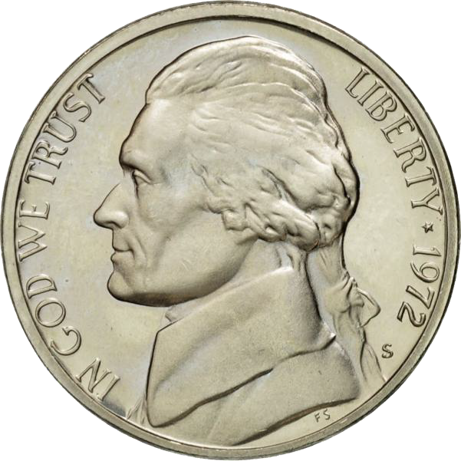
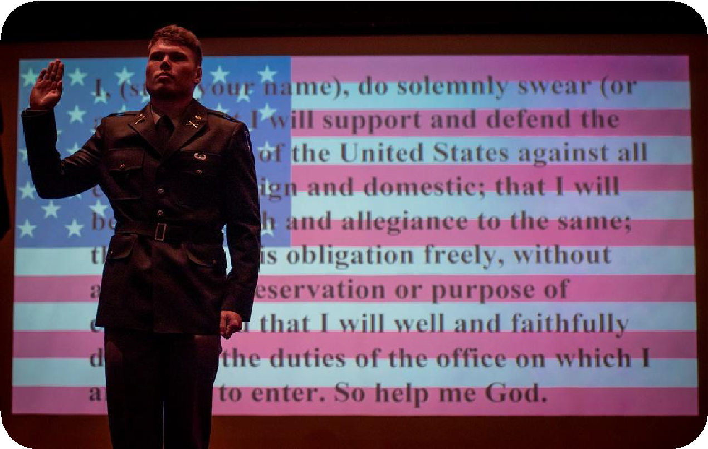
Source of the American Creed
It is grounded in our Judeo- Christian tradition—this is why our monetary currency displays “In God We Trust.”
For those of us who have had the privilege of serving our Nation, our oath of office closes with “So help me God.”
Declaration of Independence, Constitution, Bill of Rights, Federalist Papers

Slide 3


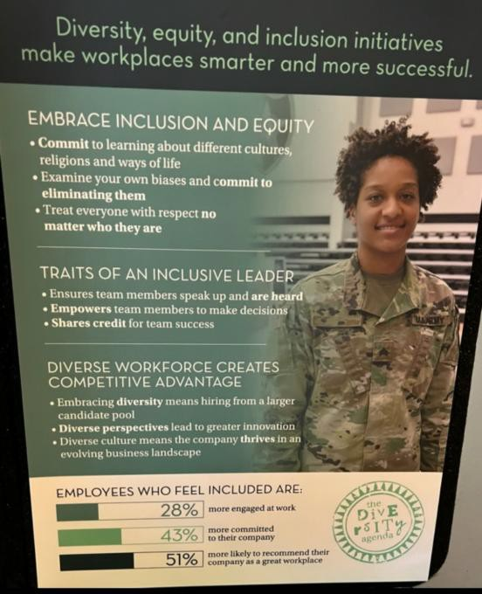

What is this threat called radical indoctrination?
Simple answer:
  Critical Race Theory advanced/inculcated through its praxis (practical application) called Diversity, Equity, and Inclusion.
  CRT & DEI

Slide 4
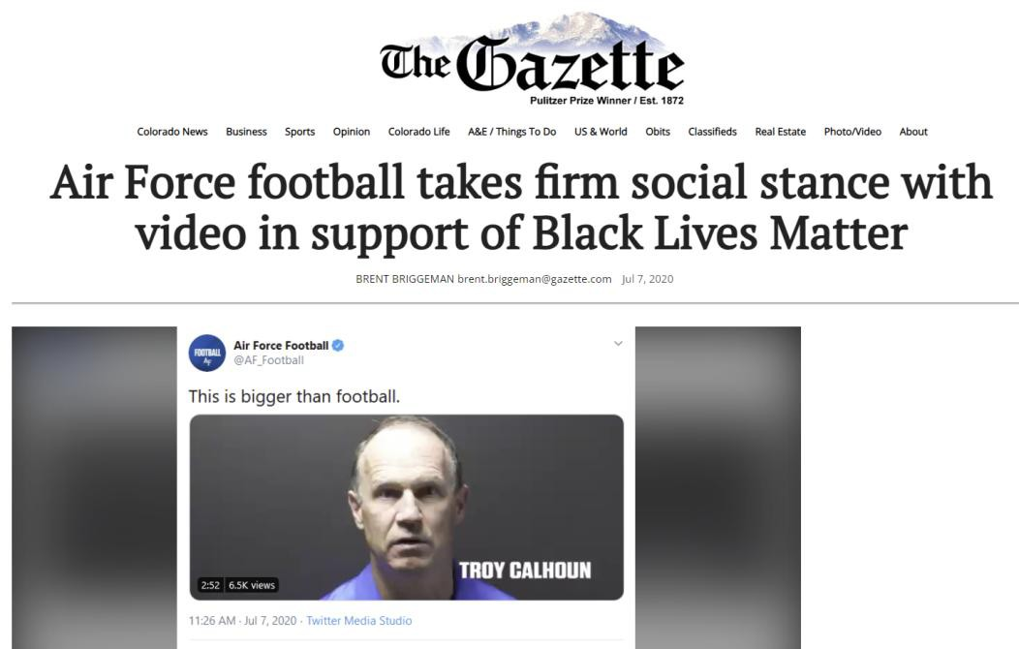








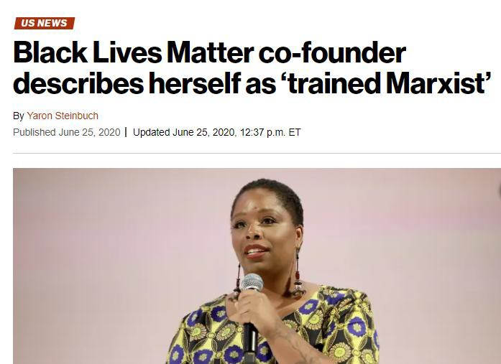







STARRS began July 7, 2020, triggered by a 3- minute video by Air Force Academy football coaches chanting “Black Lives Matter,” a movement founded and championed by trained Marxists

Slide 5


Few Anecdotes
https://starrs.us/boots-on-the-ground-perspectives/
“White Boy 2:”
  Female instructor called Air Force Academy males “White Boy 1” and “White Boy 2” and said “all you white boys [cadets] look alike to me” during the first day of a cadet Econ class. But cadets of color were called by their last names on their name tags. See Has DEI Become More Important Than Academics At The Air Force Academy?
"Five and Dive:"
  Many Air Force Academy cadets say they already have had enough DEI and will get out of Air Force as soon as their 5 year commitment is over. See: Air Force Academy Graduates Call It Quits Before Their Careers Begin
Honor Code Violation?:
  A male Air Force officer/professor thinks he is a woman and wears female Air Force uniforms/skirts. Did Air Force
Academy force cadets to lie by requiring them to call this man a “She,” because of DEI?
Political Rant:
  Another AFA instructor ranted for 10-minutes in his class of cadets regarding the new removal DEI and Transgender policy: “F… Trump, F… Hegseth! I’m going to fight this f….ing sh... We’re not going to put up with this f….ing sh... Maybe I’ll resign.”
Purple Cords: – worn by 90 cadets in AFA cadet squadrons, with alternate chain-of-command; like political “commissars”
Viewpoint Discrimination: Naval Academy tried to expel senior who defended police and opposed BLM/Antifa on social
media, while others at NA attacked police/President and praised BLM/Antifa with impunity, until federal lawsuit filed

Slide 6




Cultural Marxism is manifested via CRT/DEI to divide Americans by exploiting racial grievances and creating class warfare.
What we’re experiencing in America is not new…

Slide 7
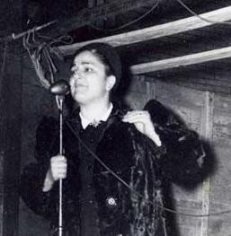





Frankfurt School’s Critical Theory in the 1930s
Marx & Engels published 1849 Communist Manifesto
Bella Dodd memorialized her seduction in School of Darkness
Unions played a key role in
educational infiltration
Herbert Marcuse, Derrick Bell, Angela Davis in 1960s
CT became CRT

Slide 8

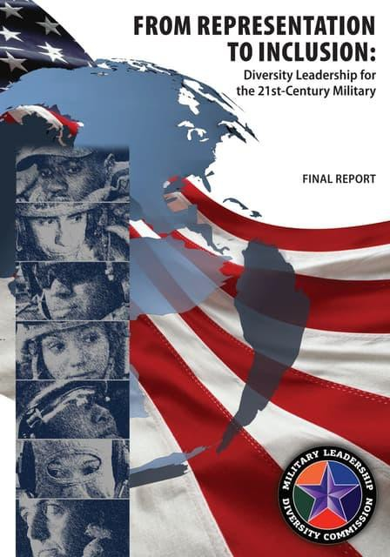
Military Leadership Diversity Commission
Fall 2008 – Congressional Black Caucus gets in NDAA; from the final report March 2011:
  “Diversity management calls for creating a culture of
inclusion . . .
  Creating this culture will involve changing the way in which people relate to one another within a single unit, within a particular military branch, and throughout the DoD.
  In particular, although good diversity management rests on a foundation of fair treatment, it is not about treating everyone the same.
  This can be a difficult concept to grasp, especially for leaders who grew up with the EO-inspired mandate to be both color and gender blind.
  Blindness to difference, however, can lead to a culture of assimilation in which differences are suppressed rather than leveraged” (p. 18).

Slide 9




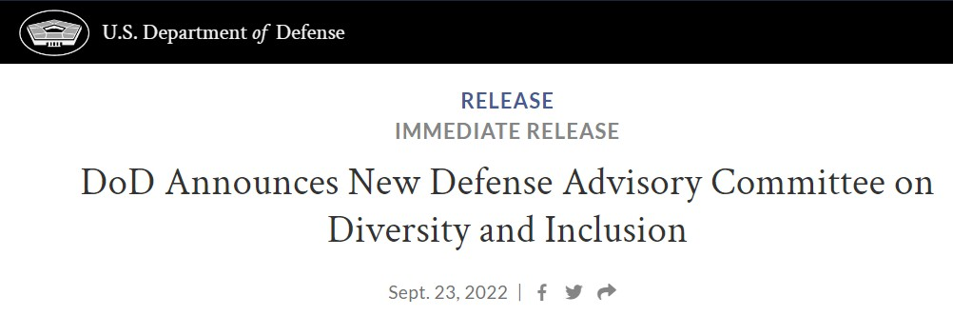
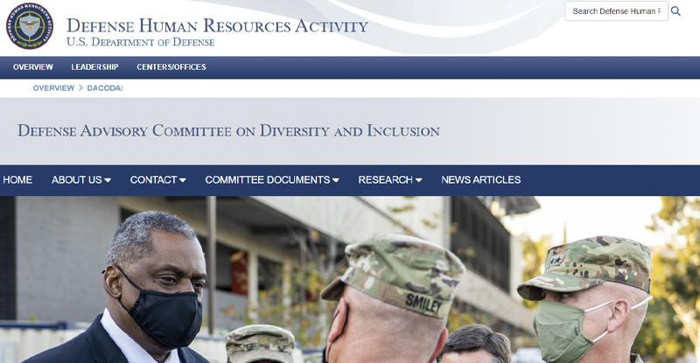
DACODAI
SECDEF Austin established the Defense Advisory Committee on Diversity and Inclusion (DACODAI) in 2022 to complete the job set out by MLDC in 2011

Slide 10


Slide 11

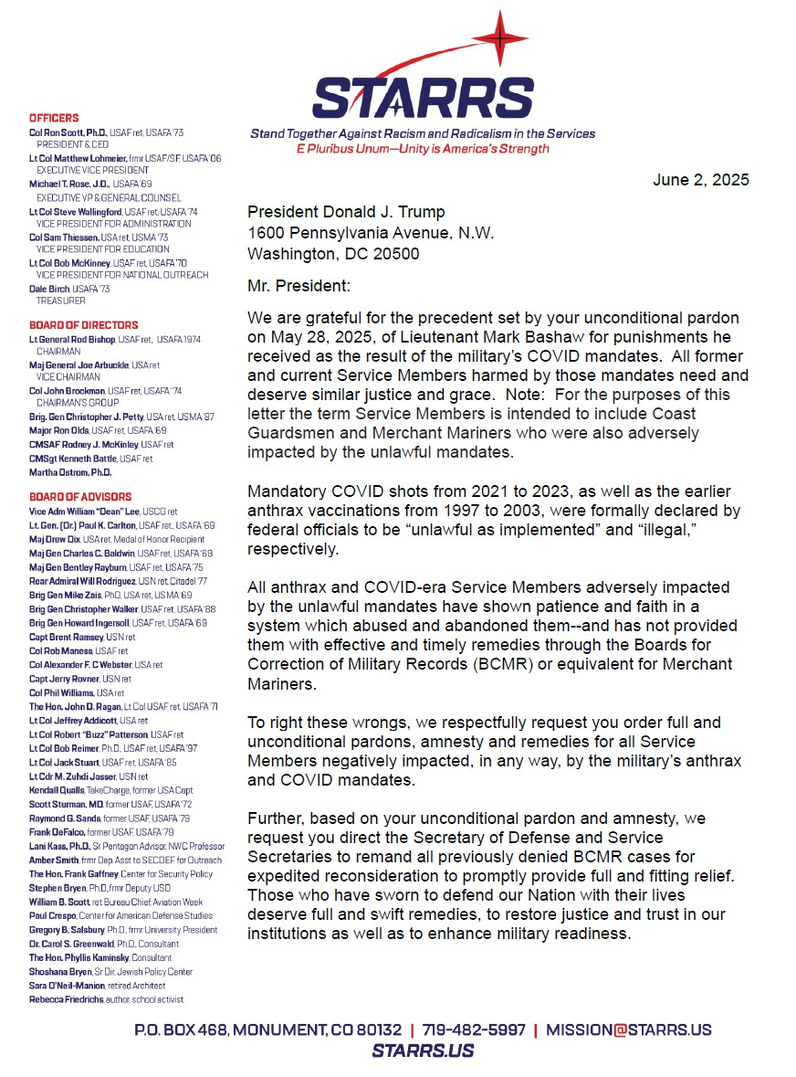
Vaccination Issue Pending
Open Letter to POTUS on June 2, 2025
Asked for Pardons/Amnesty
Vaccine mandates declared
“illegal”/”unlawful as implemented”
BCMRs ineffective, not timely
Courtesy copies to
  Cabinet Secretaries for Defense, Transportation, Veterans Affairs, and Homeland Security
  Chairs and Ranking Members for the Senate and House Committees on Armed Services and Veterans Affairs

Slide 12
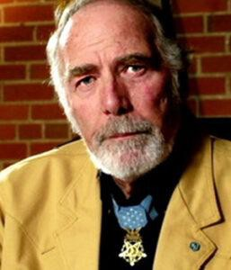
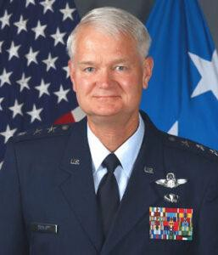
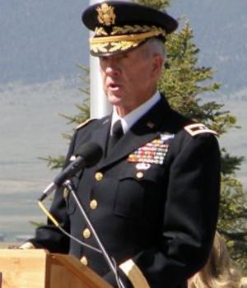
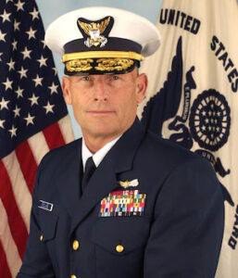
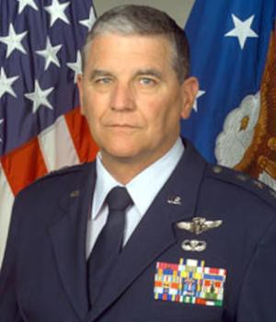
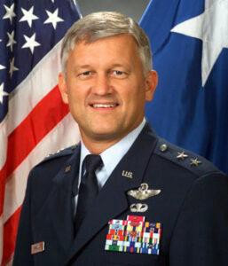
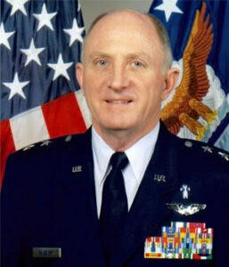
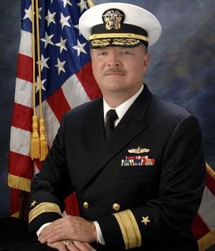
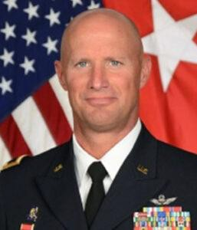
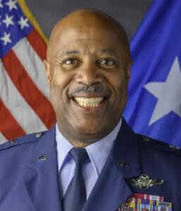
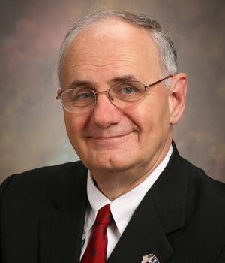

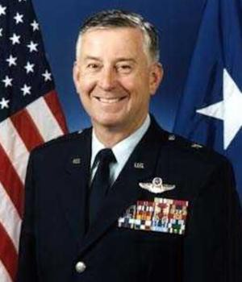
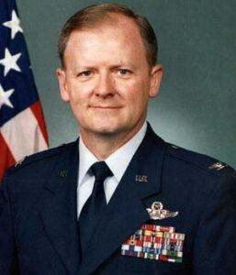
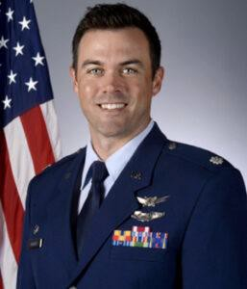
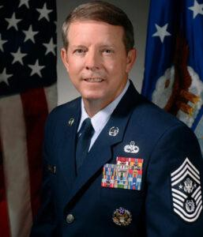
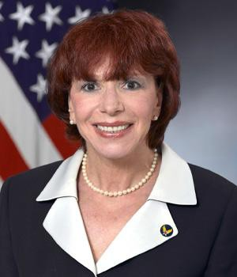
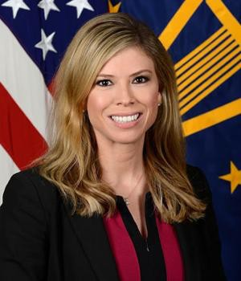
STARRS leadership and advisors are mostly retired military officers, many of whom graduated from the service academies
  Dedicated to our oaths to Support and Defend the Constitution of the United States
STARRS Officers, Directors, Advisors
Medal of Honor Recipient Flag Officers: 10
Colonels/Captains: 8
Lt. Colonels: 9
Majors: 2
15th Chief Master Sgt of USAF
Three senior former Pentagon officials State Senator

Slide 13

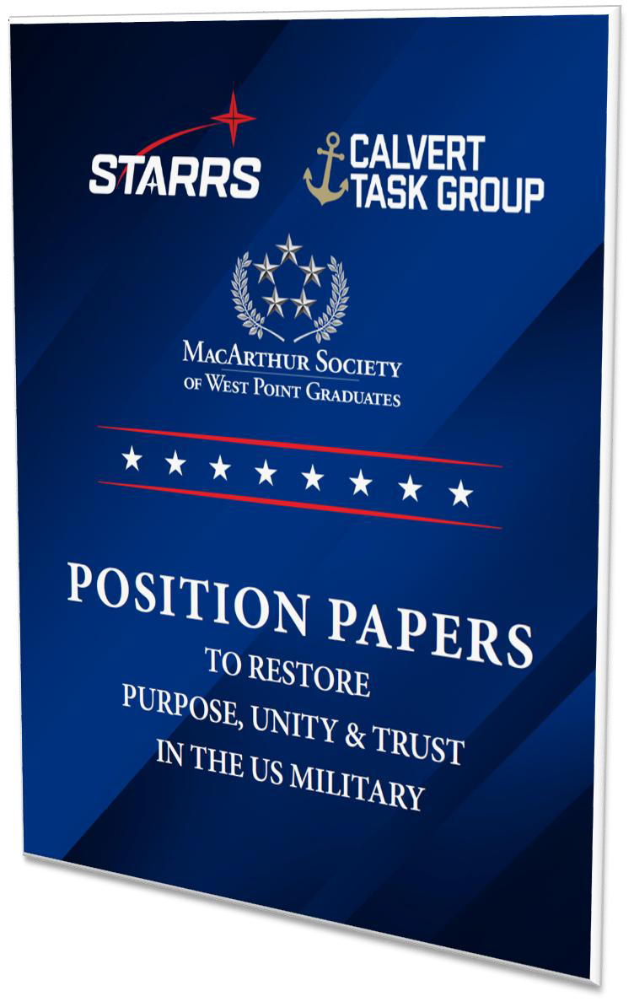
Joint Position Papers
In the first few weeks of the Trump Administration, Executive Orders have been issued to eradicate DEI and to provide remedies for those adversely affected by the Vax mandates.
We are now working with Congress to codify these policies as public law re:
  Boards of Visitors
  FOIA Requests
  National Defense Reform
  Duty, Honor, Country Commission – 3 academies
  Duty, Honor, Country Commission – 5 academies
  Dismantle DEI
  Remove DEI at USUHS and CHSR
  Data Transparency at Service Academies
  COMPAC (anthrax/COVID) Vaccine Mandate Remedies
  Transgender Policy
  Academy Admissions Reform
  Ban on Use of Race

Slide 14
Legal
Operation Rescue and Restore—143 clients
Advised hundreds of current and former military members.
Lawsuit challenging legality of military COVID mandate and denials of religious exemptions.
Lawsuit challenging DoD interference with Boards of Visitors of West Point, Naval Academy and Air Force Academy.
Freedom of Information lawsuit with Judicial Watch obtaining Air Force Academy documents.
STARRS associate Retired Brig General Chris Walker testified in the SFFA v USNA case regarding race-based admissions
Submitted an appeal to the District of Columbia Circuit Court of Appeals and filed a Petition for Writ of Certiorari to the United States Supreme Court challenging the Biden Administration’s interferences with the Boards of Visitors of West Point, the Naval Academy and the Air Force Academy
Filed dozens of FOIA requests/appeals; filed lawsuits challenging improper responses to FOIAs, via Judicial Watch
Defended/advised numerous cadets and military members regarding the military COVID vaccine mandate, DEI, etc.; resulted in reinstatement of cadets at two academies
Advised re lawsuit against Naval Academy’s race- based admissions

Slide 15
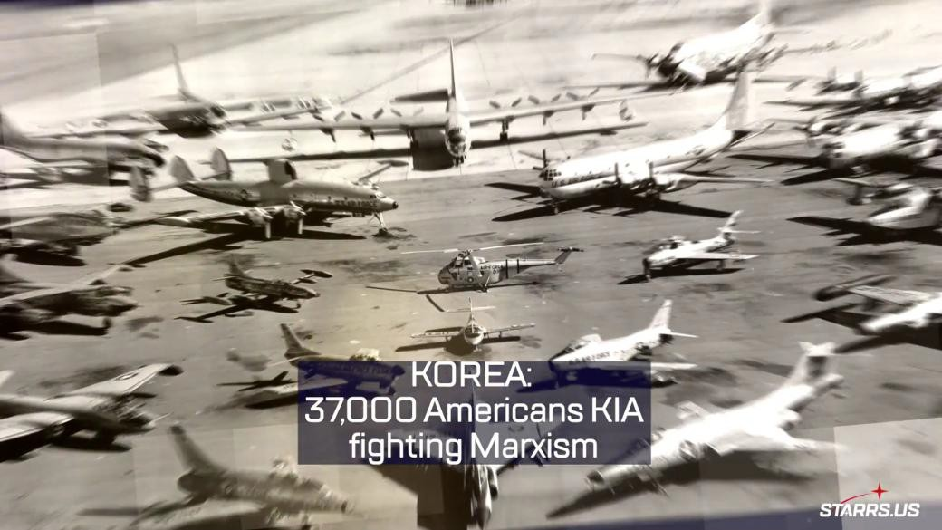
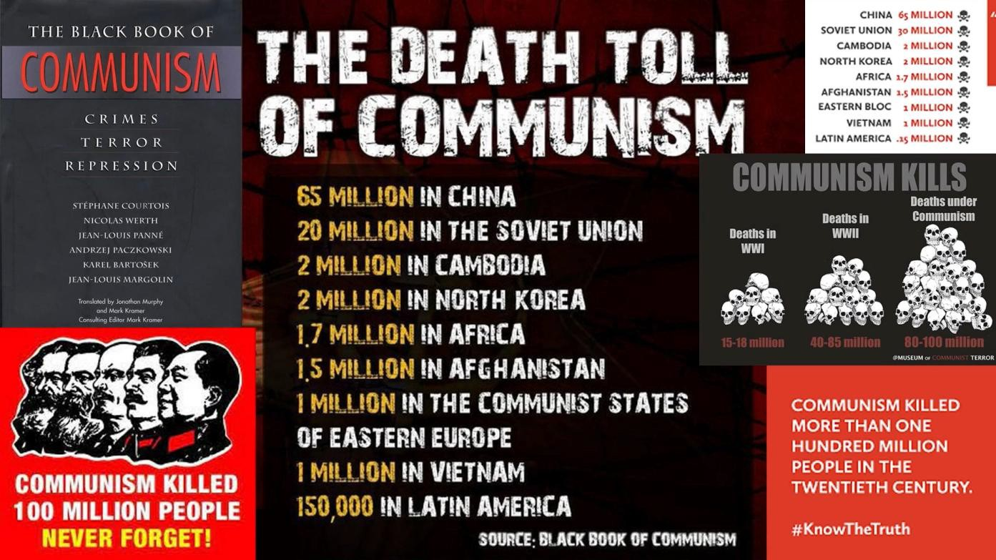
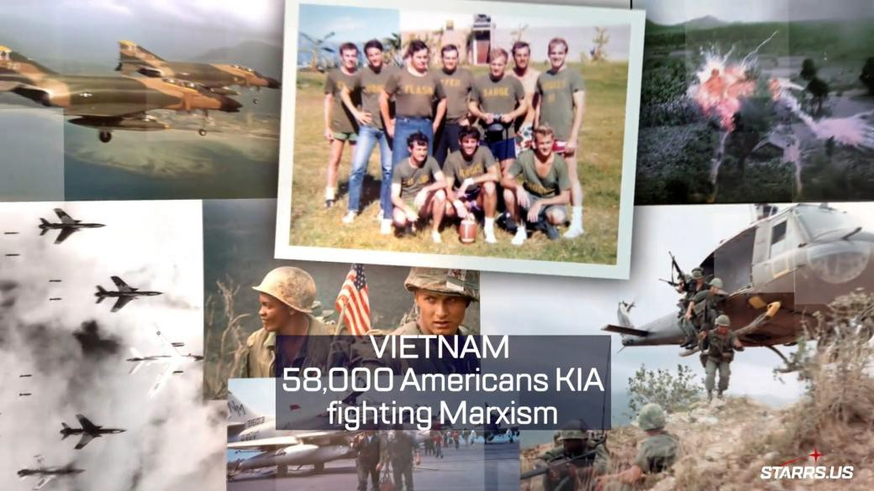
Over 95,000 American military personnel died fighting Marxism

Slide 16



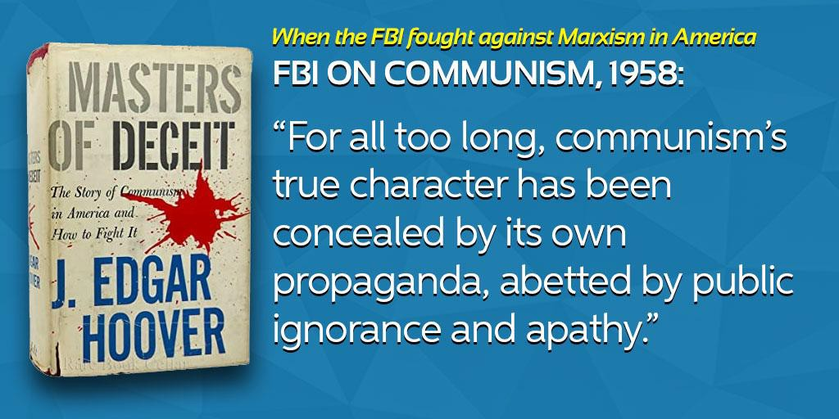

Observations
Amazing how many people have been duped to not recognize the ideological nature of CRT/DEI
These and thousands of other books tried to educate, sound the warning

Slide 17
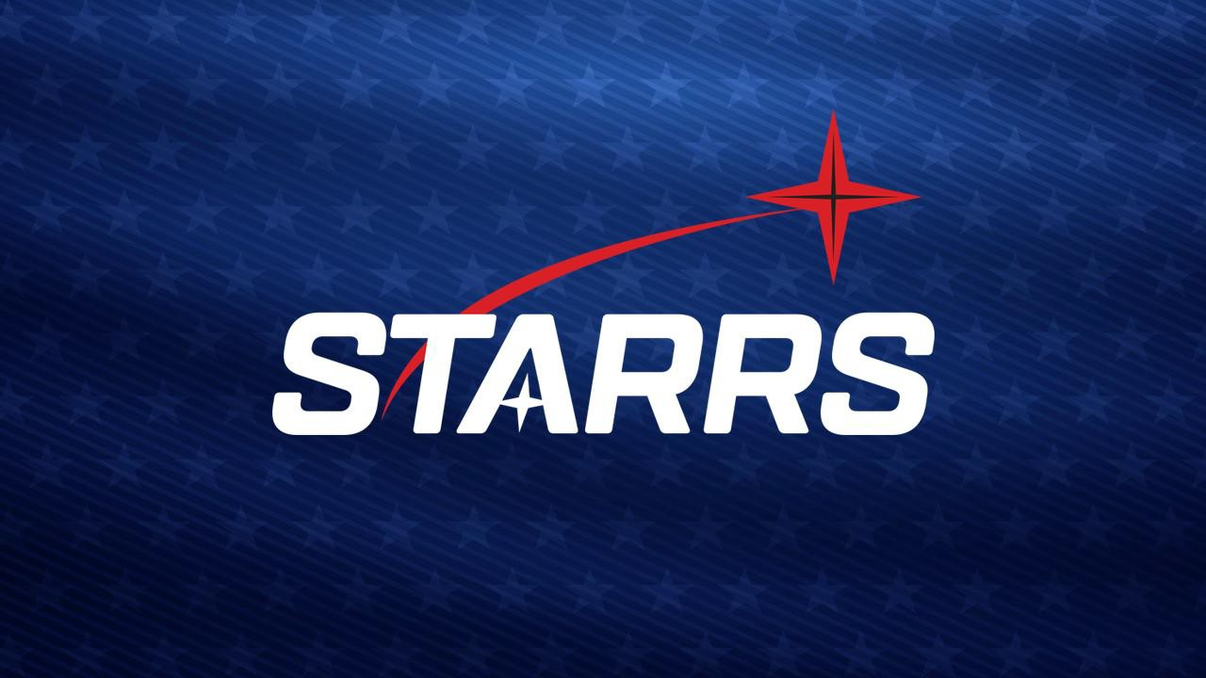





STARRS.US | Mission@STARRS.US

