Slide 1
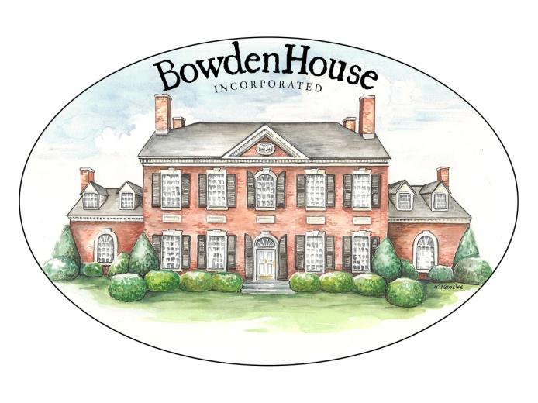
Cultural Marxism In America
How Cultural Marxism Marched Through America’s Institutions
James Atticus Bowden
Notes:
Thank you for this opportunity. I look forward to your questions and comments.
I’m James Atticus Bowden. I grew up in Arlington and Europe. I choose to live in Poquoson, Virginia in Tidewater where my back yard is The Bay.
The Virginia First Foundation dates back to 2015. We were making Virginia great again before it was cool.
We are 4 people with experience in Virginia politics, great ideas, and no money.
There are 7 institutions which shape American Culture and Civilization
This presentation will show how 5 of the 7 have been conquered by the Left
That conquest goes back to 1790 and the French Revolution
One disclaimer: The slides are too dense. I know it. We could spend 45 minutes on any single slide. I crammed in examples of the wealth of data that support my narrative. And, I acknowledge that my narrative isn’t definitive. It’s strongly suggestive on what happened and how.

Slide 2
Bottom Line Up Front
The Context of the Great U.S. Culture War Establishes Its Existential Nature
Culture Commands
Every Society has only one Culture and worldview at a time.
America’s Culture had the worldview of the American Revolution
The worldview of the French Revolution was adopted slowly by American regional Sub-Cultures
Then the evolved worldview of the French Revolution marched through America’s 7 defining Institutions as Cultural Marxism
Cultural Marxism is a branch of Human Secularist Totalitarianism
Human Secularist Totalitarianism is an existential threat to the U.S.
Not politics as usual, except for Establishment Republicans
Notes:
Let’s begin with our givens.
Colonial America had 4 starting sub-cultures. We’ll show them in a few slides.
The sub-cultures had been in conflict in the past in the British Isles. There were substantive differences from the start.
Upon our Independence there was a consensus culture that crossed and covered different regions. The consensus culture allowed for a spectrum of differences.
Key point: In all of history from tribe to civilization every society has a culture. There is only one culture at a time Culture commands. There are multi-ethnic, multi-lingual, pluralistic cultures, but never a multi-cultural society.

Slide 3
The March of Cultural Marxism
The American Left Became Human Secularist Totalitarians
America was opposing sub-cultures from the start
America had a consensus culture after Independence until 1962
Sub-Culture differences existed under a consensus American Culture
Notes:
Let’s begin with our givens.
Colonial America had 4 starting sub-cultures. We’ll show them in a few slides.
The sub-cultures had been in conflict in the past in the British Isles. There were substantive differences from the start.
Upon our Independence there was a consensus culture that crossed and covered different regions. The consensus culture allowed for a spectrum of differences.
Key point: In all of history from tribe to civilization every society has a culture. There is only one culture at a time Culture commands. There are multi-ethnic, multi-lingual, pluralistic cultures, but never a multi-cultural society.

Slide 4
On Becoming Human Secularist Totalitarians
2/3
The American Left Became Human Secularist Totalitarians
America was opposing sub-cultures from the start
America had a consensus culture after Independence until 1962
Different Enlightenments shaped 2 different Revolutions
Over time, some American sub-cultures adopted the evolved ideas of the French Revolution – Human Secular Totalitarianism
Culture War started a long time ago
Notes:
Let’s take a quick step back to the Enlightenment which was vital to our Revolution and Independence.
There were different Enlightenments. France, England and Scotland, and America had different Enlightenments.
We’ll show how – over time – two of the original American sub-cultures moved away from the consensus American Culture and adapted the evolved ideas of the French Revolution
And because they adopted those ideas – they embraced the ideas of Human Secular Totalitarianism. That’s a mouthful. My shorthand for Human Secular Totalitarianism is “Commie.”

Slide 5
On Becoming Human Secularist Totalitarians
3/3
The American Left Became Human Secularist Totalitarians
America was opposing sub-cultures from the start
America had a consensus culture until 1962
Different Enlightenments shaped 2 different Revolutions
Over time, some American sub-cultures adopted the evolved ideas of the French Revolution – Human Secular Totalitarianism
Major currents and key events produced profound change
All 7 U.S. institutions transitioned against reactionary pushback
Human Secular Totalitarians dominate 5 of 7 American institutions which define American Culture and Civilization
There’s no end in sight
Notes:
Obviously the major currents of change and key events mattered. That’s an aphorism. Yet, they need to be identified for how they mattered in America.
As the shift from American consensus culture to Human Secularist Totalitarianism happened in each institution, there was resistance. There still is. That’s why we’re still in the Culture War.
The Commies are in charge – meaning they are the majority power in 5 of our institutions today. Let’s see how that happened.

Slide 6
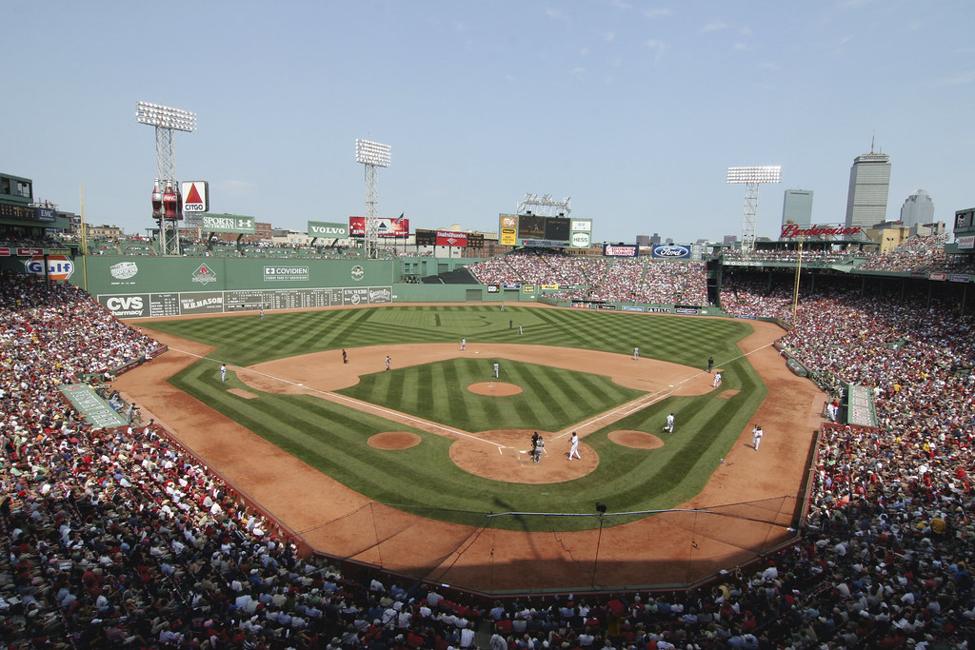
Culture Commands
What We Think, Say, and Do – Yet Individuals Have Free Will
Everything in a baseball stadium is about baseball. Culture is our personal baseball stadium.

Slide 7
Culture Sets Limits > Dictates
What We Think, Say, and Do – Yet Individuals Have Free Will
Culture
The customary beliefs, social forms, and material traits of a social group.
Includes characteristic features of everyday existence.
Education, Training
Government
War
Technology
Folklore, Legends, Myths
Music, Dance, Art
Commerce, Work
Language
Customs, Traditions, Norms
Family
Beliefs
Religion
Ideas motivate humankind for good and bad

Slide 8
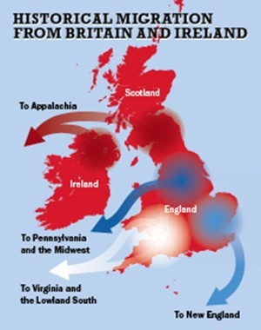
4 Founding American Sub-Cultures
Where America Came From
4 Formerly Warring Sub-Cultures
West Counties
East Anglia
Midlands
North Ireland and Lowland Scots
4.
3.
1.
2.
The immigrants from Great Britain to America had fought one another for centuries - some for a thousand years and more
Notes:
These are the first 4 sub-cultures to shape American culture and civilization.
The red dot is the Irish and Scottish Celts. They were fighting what become the white and blue dots since the Romans conquered Britain. From full invasion in 43 BC to 1745 with the last rising of the Highland Clans there was warfare. James Webb described it in his book, Born Fighting.
White dot in the West Counties are the Anglo-Saxons that were pushed out by the Vikings in the two Blue dots starting around year 800 AD.
Ultimately, Alfred the Great united the Anglo-Saxons and divided England between them and the Vikings ruling the Danelaw. He helped convert the Vikings to Christianity.
Then, while English-speaking people were colonizing America, the white, blue, and red dots fought each other during the three-way English Civil war.

Slide 9
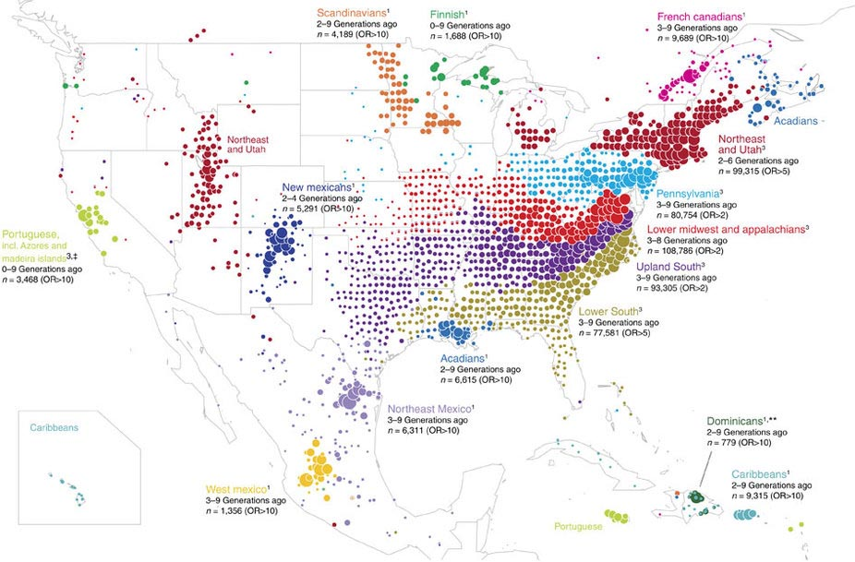
Early American Diversity
The Way We Were
Differences in “America” from the start
West Counties to Tidewater: Anglican, Cavaliers
East Anglia to New England: Puritan, Absolutists
Midlands to Middle Atlantic: Quaker and Palatinate Germans, Mercantile
North Ireland and Lowland Scots with English Borderers/Londoners to Appalachian Frontier: Presbyterian, Scot-Irish Fighters
2. New England
4.
2.
3.
3. Mid-Atlantic
4. Appalachia
4.
3.
1.
1. Tidewater
1.
2.
4 Distinct Sub-Cultures
Tidewater and New England Colonies on opposite sides of English Civil War
Notes:
From the moment the Yankees showed up in Massachusetts, the people were different. They had different accents. They had different colloquialisms. They were distinct sub-cultures.
Tidewater Virginia, Maryland, North and South Carolina were pre-dominantly Anglican. The losers of the English Civil war, the Cavaliers, shaped the live and let live culture.
New England was dominated by Puritans from East Anglia. They were absolutists. That’s why we have Rhode Island and Connecticut because of the people they drove out of Massachusetts. They were and remain a “my way or the highway” sub-culture.
The Middle Atlantic dominated by New York City and Philadelphia was dominated by Quakers from the Midlands and Germans of several dissenting Protestant sects primarily from the Palatinate area of Germany. They were all about hard work and commerce. Building great farms and making money.
The Appalachian Frontier had different people but the Scot-Irish dominated that sub-culture. The good English and German folks in Philadelphia called them the “Scum of the Earth” and pointed to the frontier to deal with Indians.
All the sub-cultures expanded westward. The Scot-Irish dominated across much of the South and West when it was frontier.

Slide 10
American Culture in 1776
Assimilated minorities
Differences in “America” from the start
West Counties to Tidewater: Anglican, Cavaliers
East Anglia to New England: Puritan, Absolutists
Midlands to Middle Atlantic: Quaker and Palatinate Germans, Mercantile
North Ireland/Lowland Scot/English Borderers/Londoners to Appalachian Frontier: Presbyterian, Scot-Irish Fighters
2. New England
4.
2.
3.
3. Mid-Atlantic
4. Appalachia
4.
3.
Other Minorities add incrementally
Black Africans
Germans
French Huguenots
Highland Scots
Swedes
Dutch
Assimilated Indians
Roman Catholics
Jews
1.
1. Tidewater
1.
2.
Not the PC, mythic multi-cultural mélange of European, Indian, African cultures.
Notes:
If you go to Jamestown, either the US National Park or the state exhibit, you will hear that, essentially, 3 co-equal cultures melded into the multi-cultural ensemble that is Virginia and America.
Not so.
The four sub-cultures dominated their regions. They assimilated others. Others contributed of course, but it was not ever multi-cultural.

Slide 11
E Pluribus Unum
America was:
Population 3.9 million
(1790) Black 760k = 19%, 60k Free, 700k Slave
98.2% Protestant, 1.7% Roman Catholic, .1% Jewish
King James Bible
English Common Law
High literacy rate
Age of 1st Great Awakening and American Enlightenment
Frontier and Agrarian Era, Early Industrial Revolution
Transportation and communication difficult
9% Speak German
Yet, 4 Distinct “Cultures” become sub-cultures
  Distinct religions
  Different accents
  Different views on government and business
Became a union of sovereign states
2. New England
4.
2.
3.
3. Mid-Atlantic
4. Appalachia
4.
3.
1.
1. Tidewater
1.
2.
1st Great Awakening and Enlightenment united Americans
Notes:
There were unifying forces to create the consensus culture called America after our War of Independence. But, the unity wasn’t whiteness as the 1619 Project and other Critical Race Theory fantasies claim. Race is a social construct to distinguish between ethnicities that are enslaved and those that aren’t. That notion of white and black exists, but it isn’t definitive for the new nation.
Religion and language unite. George Whitfield spoke to an estimated 85% of all Americans during the First Great Awakening.
English Common Law unites. There was a common legacy of limited government beginning with from the Magna Charta forward.
The temerity and results of the English removing three heads of state in the 17th century and establishing the primacy of parliament was shared among the colonists.

Slide 12
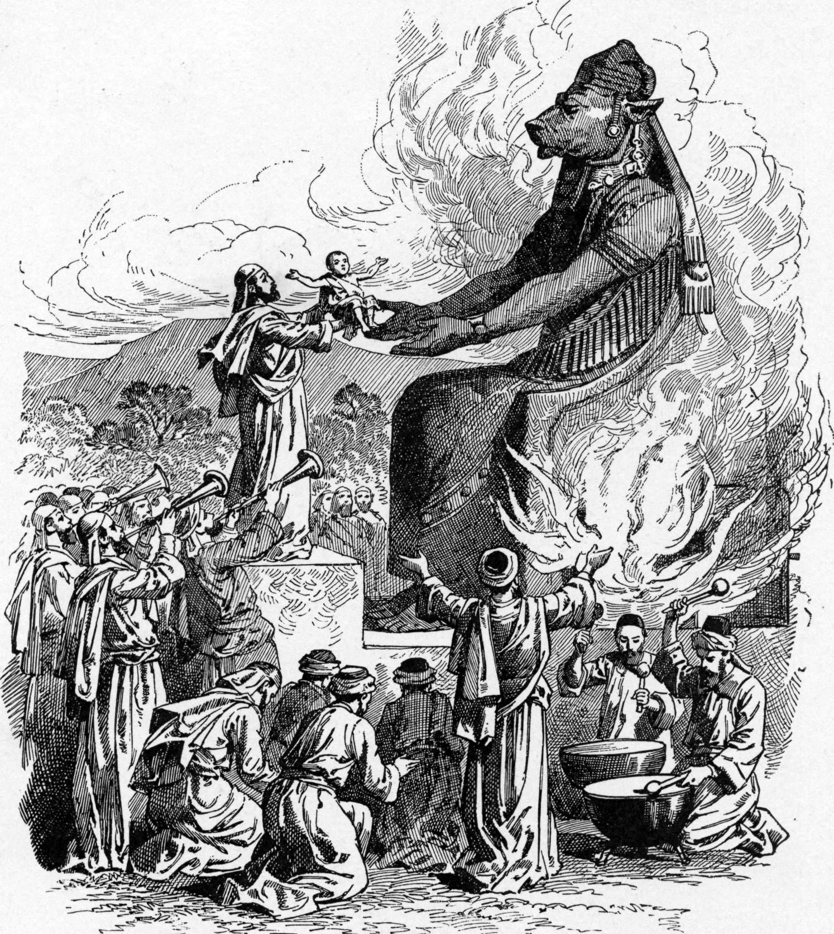

Different Enlightenments
Produced different results
France
Ideology of Reason
Rousseau – Concept of the General Will, Education is too important to leave to fathers
Montesquieu – Separation of Powers
Voltaire – Reason should rule
Diderot – Editor of the Encyclopedie
Turgot – The Poor have rights on the abundance of the Rich
Condorcet – Constitutional government
The Enlightenment narrative was highjacked by Human Secularists in the 19th Century
Notes:
Let’s return to the Enlightenments to see what that means.
The French Enlightenment focused on the Ideology of Reason. It was decidly anti-cleric which meant anti-Roman Catholic in France. There were believing Christians in the French Enlightenment, but they weren’t the big influencers – to use a social network term.
That anti-religious, anti-Christian, anti-Bible attitude became popularized by Human Secularists everywhere in the 19th Century. The Enlightenment is taught in this color today.

Slide 13
Different Enlightenments
Produced different results
Great Britain
England and Scotland
Sociology of Virtue
John Locke – Natural individual rights, consent of the governed
Isaac Newton – God is always and everywhere
Adam Smith – Perfect liberty…laissez-faire capitalism
Edward Gibbons – Rationalist history
Edmund Burke – Natural law
Joseph Priestly – Rational Christianity, freedom of speech, worship, and education
William Godwin – Individualism
Mary Wollstonecraft – Social equality for women
David Hume – Utilitarianism
Frances Hutcheson – Ethical theory includes inner senses of morality and honor
France
Ideology of Reason
Rousseau – Concept of the General Will, Education is too important to leave to fathers
Montesquieu – Separation of Powers
Voltaire – Reason should rule
Diderot – Editor of the Encyclopedie
Turgot – The Poor have rights on the abundance of the Rich
Condorcet – Constitutional government
The Enlightenment narrative was highjacked by Human Secularists in the 19th Century
Notes:
While the Enlightenment in England and Scotland included some agnostics and atheists, it had others, like Sir Isaac Newton who were devoutly Christian.
In fact, the Enlightenment was empowered and energized by combining an unseen sovereign, creator God from Jewish mysticism, with the independence from ecclesiastical authority on how to know knowledge from the Protestant Reformation, with the rational empiricism from ancient Greece. The world of natural sciences is discoverable because it is designed.

Slide 14
Different Enlightenments
Produced different results
Great Britain
England and Scotland
Sociology of Virtue
John Locke – Natural individual rights, consent of the governed
Isaac Newton – God is always and everywhere
Adam Smith – Perfect liberty…laissez-faire capitalism
Edward Gibbons – Rationalist history
Edmund Burke – Natural law
Joseph Priestly – Rational Christianity, freedom of speech, worship, and education
William Godwin – Individualism
Mary Wollstonecraft – Social equality for women
David Hume – Utilitarianism
Frances Hutcheson – Ethical theory includes inner senses of morality and honor
France
Ideology of Reason
Rousseau – Concept of the General Will, Education is too important to leave to fathers
Montesquieu – Separation of Powers
Voltaire – Reason should rule
Diderot – Editor of the Encyclopedie
Turgot – The Poor have rights on the abundance of the Rich
Condorcet – Constitutional government
America
Political Liberty
Benjamin Franklin – Declaration of Independence and Constitution
Thomas Jefferson – “All men are created equal”
Benjamin Rush – Medicine, chemistry, psychiatry
James Madison – Constitution, Federalist Papers
Alexander Hamilton – Federalist Papers
John Adams – Constitution made only for a moral and religious people
Thomas Paine – Government is a necessary evil
George Mason – Bill of Rights, VA Declaration of Rights
John Witherspoon – Scotland to Princeton University
George Washington – Farewell Address
The Enlightenment narrative was highjacked by Human Secularists in the 19th Century
Notes:
Our American Enlightenment focused on political liberty. Thinking American went through an if-then exercise to arrive at revolution. It’s hard to find explicit instructions to revolt in the Bible. But, Americans used natural law implicit in the Bible as the justification for overthrowing the state. We recall that their British ancestors set the precedent replacing three heads of state in the 1600s.

Slide 15
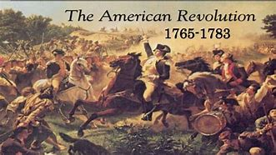
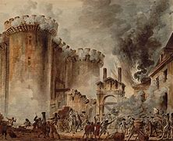
Two Revolutionary Worldviews
America doesn’t embrace the new Paganism
American Revolution
1775
French Revolution
1789
Keeps the Biblical World View from Great Britain
The Christian God – Father, Son, Holy Spirit – lives
Life is a sacred gift from God. Man created in God’s image.
Law originates with God. Natural laws are supreme
Individual Rights come from God. God, alone, is just
Individualism is important: Salvation and Responsibilities
Humans are born evil
God ordains private property and personal profit earned honestly
Everyone who can work must work
Wisdom is knowing God
Ten Commandments are ethical and moral basis for society
America has new birth in freedom without the destruction of the past
Notes:
The new American consensus culture has a worldview. It isn’t far from Great Britain’s. We had what is called a “conservative” revolution that changed that didn’t overthrow the legal structures and cultural norms. For example, there was a governor of Virginia before the Revolution, during the Revolution when Virginia declared itself an independent state, and after the Revolution, the Articles of Confederation and 1787 Constitution.

Slide 16
Two Revolutionary Worldviews
America doesn’t embrace the new Paganism
American Revolution
1775
French Revolution
1789
Keeps the Biblical World View from Great Britain
The Christian God – Father, Son, Holy Spirit – lives
Life is a sacred gift from God. Man created in God’s image.
Law originates with God. Natural laws are supreme
Individual Rights come from God. God, alone, is just
Individualism is important: Salvation and Responsibilities
Humans are born evil
God ordains private property and personal profit earned honestly
Everyone who can work must work
Wisdom is knowing God
Ten Commandments are ethical and moral basis for society
Embraces Human Secularism as a New Religion
There is no God
The state is supreme
Government designed to create peace, union, and equality
Government represents the “General Will” of the people
There are group rights for protected classes of persons
Life is a conditional gift from the government – because if it is expedient for the government that a person or group of persons should die, then they must die
Humans are born “tabula rasa” and can be made more perfect
Justice comes from reason alone
Two very different, antagonistic worldviews
Notes:
France tries to change everything. They abolished the Estates General which dated back to 1302. They changed the calendar. They changed how many days in a week.
They had lovely words - “liberty, equality and fraternity” - that didn’t work out. When they failed to achieve equality, they found an enemy to blame. The nobility, bourgeoisie, and clerics were the problem. The Terror was about killing them to solve the problem.
The French worldview is antagonistic to the American worldview – even though we have celebrated each other’s revolutions through the years.

Slide 17
America (Was)
America Is Ideas in one Place, Spoken in English
Initial American Creed
English language
Christianity – Judeo-Christian
Religious commitment
English Rule of Law
Responsibility of Rulers
Individual Rights: equality, autonomy
Dissenting Protestant values of Individualism
Work ethic
Enlightenment duty and expectation to “do better” civically
Heritage of European literature and art
Dissident Protestantism without God
becomes
Consensus Culture. Not “Whiteness.”
Notes:
So when the 1787 Constitution was ratified by 1789, America had a fledgling consensus culture. This culture included whites and blacks. It included Protestants, Catholics, and Jews.
America became a set of ideas held in common.

Slide 18
America Is (Was)
America Is Ideas in one Place, Spoken in English
Initial American Creed
English language
Christianity – Judeo-Christian
Religious commitment
English Rule of Law
Responsibility of Rulers
Individual Rights: equality, autonomy
Dissenting Protestant values of Individualism
Work ethic
Enlightenment duty and expectation to “do better” civically
Heritage of European literature and art
Dissident Protestantism without God
becomes
American Identity
English language
Political – America is shared ideas
Religious symbols
Ideological
  Liberty – God-given Rights
  Equality – opportunity and respect
  Individualism – conscience and responsibility
  Pluralism and Populism
  Laissez-faire economics
War Experience – blood tax
Consensus Culture
More, different people became fully American
Notes:
The American Creed became an American Identity.
It’s who we agree we are.
Our religious identity shifted from Protestant to Christian to Judeo-Christian. And from public confession and practice to symbols.
America had a consensus culture. Once Boston finally gave up the 5th of November “Pope Night” where effigies of the Pope, Devil, and some politicians were bashed, we had a common set of holidays.

Slide 19
American Culture Perspective
Ideas and cultures evolve through time
SCOTUS Ends School Prayer in U.S.
Human Secular Totalitarianism
French Revolution
1789
Spring Revolutions
1848
Paris Commune
1870
European Turmoil
1968
Cold War Ends
1991
WW I
1914-1918
WW II
1939-1945
1962
9-11
2023
Jefferson
1.Tidewater
American Exceptionalism
4.Frontier (Appalachia}
3. Middle Atlantic
Hamilton
2.New England
Ideas have a genealogy
Notes:
Let’s put it on the timeline. The red arrow is the expanse of our American Consensus culture with the political horizons of Jefferson on the Left to Hamilton on the Right.
The founding four sub-cultures fit within the consensus culture which celebrated American Exceptionalism.
On our left there is the French Revolution.
In 1962, the consensus culture cracks openly. It’s a handy demarcation. Others could work as well, but the Supreme Court decision banning Christian prayer in public schools was a definite break in the former consensus culture.

Slide 20
American Consensus Culture
From Hamilton to Jefferson was American
SCOTUS Ends School Prayer in U.S.
Human Secular Totalitarianism
French Revolution
1789
Spring Revolutions
1848
Paris Commune
1870
European Turmoil
1968
Cold War Ends
1991
WW I
1914-1918
WW II
1939-1945
1962
9-11
2023
Jefferson
1.Tidewater
American Exceptionalism
4.Frontier (Appalachia}
3. Middle Atlantic
Hamilton
2.New England
Some American Subcultures shift left to accept the ideas of the French Revolution
Notes:
From 1790 to 1962 and beyond a governing majority of New England sub-culture and Middle Atlantic sub-culture including its migration to San Francisco, Chicago, Seattle, and later to Los Angeles adapted the evolved ideas of the French Revolution.

Slide 21
Ideas of the French Revolution Sow Bad Seeds
Allies with Islamist Totalitarianism
French Human Secularist Totalitarianism Grew Other Totalitarianisms
Fascism
National Socialism
Climate Cult Greens
Woke
Anti-Racist
Human Secular Totalitarianism
Socialism
Hitler
Marx
Communism
Cultural Marxism
Left
Liberalism
Progressivism
U.S. Democrats
Hegel
Lenin
Stalin
Robespierre
Darwin
Freud
Frankfurt School
Gramsci
French Revolution
1789
Spring Revolutions
1848
Paris Commune
1870
European Turmoil
1968
Cold War Ends
1991
WW I
1914-1918
WW II
1939-1945
1962
9-11
2023
Wilson
FDR:
New Deal
Dewey
1.Tidewater
Jefferson
American Exceptionalism
4.Frontier (Appalachia}
3. Middle Atlantic
Hamilton
2.New England
Human Secular Totalitarianism evolves into many Totalitarianisms
Notes:
The bad news from the French Revolution doesn’t end with a busy guillotine during the Terror.
The French Revolution sows bad seeds in new thinkers trying to make it work right. You’ve heard the line about the socialism or communism that just hasn’t been done rightly before.
This isn’t an exhaustive list of Leftist contributions to the bad seed. It’s illustrative of some key figures.
The ideas have a name. They are Human Secularist Totalitarianism.

Slide 22
Major Currents of Change
America Is Center-Right
From Frontier to Agrarian to Industrial to Information Eras
Urbanization and automobile-based society
From Manifest Destiny to World Power to Super Power to Sole Uber Super Power to Present (TBD)
From Assimilation of Catholics to Exclusions and Ellis Island to 1924 to Post WW 2 to 1965/1986 Immigration Acts to Illegal Alien Invasion
Jefferson
1861-1865 The War
1941-1945 The Other War
1960s Split
1790
1810
1830
1850
1870
1890
1910
1930
1950
1970
1990
2010
2020
1914-1918 Shock
1929-1939 Shock 2
Hamilton
Black experience from slavery to segregation to Civil Rights Movement to reverse discrimination & CRT
4 Great Awakenings to Post-Christian Paganism
Growth and power of the Federal Government, Shredding of the Constitution, Institutionalized Welfare State
Evolution of Public Education
Motion pictures, radio, television, internet influence
Sexual revolution and roles of women in society
1.Tidewater
Change is obvious, but wasn’t deterministic
Notes:
Other things happen in America and around the world other than Leftists developing new theories of unworkable tyranny.
In America we have our greatest period of disunity and our worst war ever in what post war newspapers sometimes called the Recent Unpleasantness of 1861-1865. It changed America. Two of the founding sub-cultures were devastated and subordinated to the two that triumphed in arms.
Our greatest period of unity ever was during World War 2. America went from being the world power it had been since the turn of the 20th century to a super-power in a bi-polar world. The Pax Americana of US military and economic power ordered the Free World.
World War 1 and the Great Depression shocked Western Civilization. It shook it to its core. The moral-ethical foundation was found wanting by millions of people. The Establishment lost its confidence to defend itself. What had been growing since 1790 bore bad fruit.
We see a deliberate break in 1962.

Slide 23
Slowly, Sub-Cultures Shifted Left
Half of America Adopted the Evolved Ideas of Human Secular Totalitarianism
Fascism
National Socialism
Cultural Marxism
Woke
Anti-Racist
Socialism
Hitler
Pol Pot
Human Secular Totalitarianism
Marx
Communism
Ho Chi Minh
Left
Liberalism
Progressivism
U.S. Democrats
Lenin
Stalin
Mao
Climate Cult Greens
Hegel
Facism
Freud
Gramsci
Castro
Maduro
Robespierre
Darwin
Frankfurt School
French Revolution
1789
Spring Revolutions
1848
Paris Commune
1870
European Turmoil
1968
Cold War Ends
1991
WW I
1914-1918
WW II
1939-1945
1962
9-11
2021
Dewey
FDR:
New Deal
BHO
Wilson
SCOTUS: Makes up Rights
LBJ: Great Society
1.Tidewater
5.Urban Jewish
6.Urban Black
Jefferson
American Exceptionalism
4.Frontier (Appalachia}
Rural vs Urban divide is nation-wide.
Indivually-held Worldview.
Accentuated by regional sub-culture differences & plurality by place.
3. Middle Atlantic
Hamilton
2.New England
Which way for new Immigrant Subcultures: #7. Hispanic(s) and #8. Asian(s)?
Notes:
New people are assimilated into the founding sub-cultures. Two sub-cultures morph into one called The South in 90 year recovery from the War. New sub-cultures arise.
There is Jewish urban and Black urban.
New sub-cultures may be developing now.
And, there is change from the regional identification – although regions where there is a governing majority by worldview clearly exist – to a rural and small town vs large urban split.
Worldviews are held individually everywhere.

Slide 24
How It Happened
Like a slowly metastasizing cancer or the slow build up to an avalanche of snow
Slow assault on the 7 institutions which shape American Culture and Civilization
Government 2. Business 3. Education 4. Media 5. Arts and Entertainment 6. Religion 7. Family
Began in Education
Educated elites leading other institutions were agents for change
Dominated and colored by the New England and Middle Atlantic sub-cultures
Jefferson
From the secularization of higher education to the adoption of the ideas of the French Revolution
1790
1810
1830
1850
1870
1890
1910
1930
1950
1970
1990
2010
2020
Change for Americans to identify by moral and cultural values more than by region, religion, ethnicity and politics
However, the cultural values have regional homes which shape their nature
Hamilton
Going from one worldview to a different worldview: Required new ideas, messaging through media, building communities, key persons as leaders, advantages to women, adaptation by families, enough elites to give credibility, desirable education opportunities, incentives, and coercion
Interests organized and monetized very well to influence
Establishment confidence collapsed and counter-movements were insufficient
The Tidewater and Frontier sub-cultures didn’t change – concurrently or largely
1.Tidewater
The Great U.S. Culture War Isn’t Over – Yet
Notes:
My cancer or avalanche analogy may be a reach. I believe that’s how it happened through time.
The catalyst, to use another analogy, was the transformation in the institution of education. Higher education moved from Christian colleges and universities to secular schools. They adopted the ideas of the French Revolution and gave the bad seed new names. They are Cultural Marxists.
Americans changed their self-identity.
Yet, the sub-culture imprint on how we live remains.

Slide 25


Seven Mountains Of American Culture
7 Institutions Shape America
The Elite “Left” dominates 5 mountains.
Family
Government – military
Business
Education
Media
Arts & Entertainment
Religion
Family
Business
Education
Religion
Arts & Entertainment
Government - Military
Media
Slim, yet potentially governing, majority of Americans are more or less Conservative, but the majority of the ruling power is Leftist – Human Secularist Totalitarians.
Notes:
Calling the institutions “mountains” is a handy metaphor. They could be pillars as well for an American temple.
Human Secularist Totalitarian elites rule on five mountains.
There’s a distinction between big business and small business. The elites run big business. Many Conservative families still run small businesses.
The elites are supported electorally by the entitlement underclass living on the government plantation.
The huge middle class of wage earners, independent professionals, and small business owners could be a governing majority larger than FDR’s coalition. FDR’s coalition ruled for 50 years.

Slide 26
Education
Strategic key to change American culture
Higher Ed from Protestant Sectarianism to Non-Sectarian to Ecumenical to Secular to Anti-Christian
1800s: German Influence: Bildung (education builds character) to Lehrfreiheit (freedom of guild of professors to pursue inquiry, publishing, teaching) to Wissenshaft (sanctified moral ideal of a scientific search for truth) to 1900s Frankfurt School (Cultural Marxism)
Left
Left
Northern Exclusiveness after The Recent Unpleasantness
Jefferson
U Chicago: Pragmatic Enterprise
Princeton: Church distinct from society
Social Gospel
Berkely: Free Speech Movement
Foreign Finances
Columbia: Frankfurt School
Moral Philosophy > Theology
U Michigan: Prussian model faculty
Dewey
Youth Movement: Growth of HS
NEA
Federal funding Higher Ed
Darwin!
Football
Vietnam War
Public Ed decline
1790
1810
1830
1850
1870
1890
1910
1930
1950
1970
1990
2010
2020
Theology: Queen of Sciences
Notre Dame Catholic U
Buckley
Regent U
Liberty U
Homeschooling
Christian Ed
Grove City
Hillsdale
Presbyterian Colleges
Methodist Colleges
HBCU
Yeshiva
Low Church Colleges
Hamilton
Anti-dogmatism became dogmatic rejection of theology – without regard to academic credentials
Vietnam War: Higher Ed a refuge for draft dodgers and gateway to lifetime employment
From Anti-War to non-Western religions to Anti-Western Civilization
Right
Right
Public Schools: From Civil Rights battleground to Court interventions to Woke Indoctrination Camps
Sectarian Schools reflect the shifts and splits in their denominations
Unintentional consequences of repeated incremental reforms in one direction only
Notes:
In the beginning – Education. Higher ed went from deeply Christian sectarian Protestant schools to non-sectarian Protestant to Ecumenical to Secular to Anti-Christian hostility. This shift could be characterized as small steps based on good intentions with unforeseen consequences.
It took a hard twist when over 8000 scholars studied in Germany during the 1800s. These scholars became infatuated with German concepts of higher education and infected with Human Secularist Totalitarianism.
Examples: Theology – foundation of worldview which shapes the study of other fields. Etc.
There are counter movements but they aren’t equal to the momentum in the dominant sub-cultures
The Vietnam War accelerated everything.
The elites for 150 years go from Higher Ed to leadership in every other institution.

Slide 27
Government
Significant differences among Federal, State, Local Governments
1865: Federal government dominates. New England and Middle Atlantic sub-cultures & their elites rule.
1900s: Progressive Movement to FDR Socialism to Welfare State to Surveillance State shredding of the U.S. Constitution by Federal Executive, Legislature, Judiciary
Left
Post WW2: Growth of the Deep State bureaucracy
Military-Industrial Complex is big business
Left
Post Cold War: Global Elite Idealism
Jefferson
Pandemic Police State
Civil Service Act
Progressive Movement
New Deal
Great Society
Military Social Experiments
Obamacare
1790
1810
1830
1850
1870
1890
1910
1930
1950
1970
1990
2010
2020
Judicial Tyranny
Jacksonian Democracy
Congress dominates
9-11 Unity Blip
Free State of Florida
Reagan
Conservative SCOTUS?
Hamilton
1960s: Poverty and Race become a government-run business
1968: Democrat Party went Left and never stopped going
Right
1969 Milk Subsidy: Lobbying becomes big business.
Right
1999: Clinton Impeachment: Rule of Law ignored
Culture War: Urban vs Rural divide
Elections matter. Teeter totter can move fast and hard – when weight is applied
Notes:
Our American highway to hell in Government is well-documented.
The big break with the consensus culture comes with judicial tyranny. Empowered by the moral-ethical cloak of civil rights, the judges become black-robed, priest kings.

Slide 28
Business
Big Business Corporateness vs. Small Business Independence
U.S. has always been Government and Business in a mixed economy. Government’s role increased unceasingly
20th Century: Creation of elites from graduate business schools
Left
New Deal: Federal Commerce Clause extended to intervene pervasively into private businesses
Left
Post WW 2: Monetary stability from Bretton Woods to US dollars as international reserve currency.
Post WW 2: Governments at every level become major employer, purchaser of goods and services and the Regulatory State
Jefferson
Harvard Business School
Bretton Woods
Tech Oligarchs
Progressive Movement
Greens Cult
Anti-Trust
EPA
1790
1810
1830
1850
1870
1890
1910
1930
1950
1970
1990
2010
2020
New Deal
Oil Shock
Globalization:
Loss of US Industry
Unions
Hamilton
1960/80s: From Equal Opportunity to Divestiture to Social Equity
1970s: Racial shakedowns of big corporations
Right
2020: Pandemic submission and Trans insanity
Right
Special interests are able to pressure corporations
Small business is 60% of the US Economy
Comprehensive Transitions from Agrarian Era to Industrial Era to Information Technology Era
From Laissez-Faire to Crony Capitalism
Notes:
Business and government operate in a mixed economy for all of time. America had a more limited government and laissez-faire arrangement until the shock of the Great Depression.
Government didn’t let the crisis go to waste.

Slide 29
Media
A Free Press Is a Constitutional Requirement
From a Revolutionary Press to the Yellow Press to One-sided Corporate Entertainment News
News is easier to access, but there are fewer sources of content and less range in the content in corporate media
Left
1970s: Pentagon Papers and Watergate cement media partisanship
Left
Jefferson
Social Network Censorship
Open Religious Skepticism
Yellow Press
U. Missouri: School of Journalism
Columbia
Pentagon Papers & Watergate
CNN: 24 hr News
1790
1810
1830
1850
1870
1890
1910
1930
1950
1970
1990
2010
2020
1970s
Sermons Published
Lincoln’s Abuses
Motion Pictures
Hays Code
Rush Limbaugh & Talk Radio
Fox News
Scopes Trial
Radio FCC Regulated
Bishop Sheen
3 TV Channels
Hamilton
1968: Cronkite on Vietnam, Chicago Democrat Convention Police Riot
1971: Pentagon Papers reveal Classified Defense documents
Right
1972-4: Watergate brings down POTUS
Right
1980: CNN and 24 hour news cycle
2006: Wikileaks reveal US Government secrets
The Mainstream Media is monolithic and Politically Correct to the extreme
Notes:
The media went from diversity of ideas to homogeneity to more diversity.
The media changed with technology and government involvement in new means of communicating.
The big break when the mainstream media openly went Left was the 1970s – another outcome of the Vietnam War division.

Slide 30
Arts and Entertainment
What the public wants and authorities allow
19th Century establishes American literature, arts, and entertainment in Western Civilization
20th Century explosion of literature, arts, and entertainment unto Cultural Imperialism
Left
1960s: Open “breaking barriers” – continues with no end in sight
Left
21st Century trivializing culture and defining deviancy down
Jefferson
Professional Sports are all-American
Porn Industry
Hollywood
Motion Pictures
Pro Sports
Minstrel Shows
Ziegfield & Harlem
Broadway
TV
Evolving Internet
Disney
Cable TV
1790
1810
1830
1850
1870
1890
1910
1930
1950
1970
1990
2010
2020
1960s
Uncle Tom’s Cabin
Motion Pictures’
Hays Code
Christian
Broadcasting
Muckrakers
Radio FCC Regulated
Nashville
Country Music
Christian Music & Entertainment
Hamilton
1966: Film released without MPAA approval
1987: National Endowment of the Arts pays for Piss Christ
Right
1989: Too Live Crew obscenity case goes to SCOTUS
Right
1995: Impact of Selena’s death surprises
2001: Impact of Dale Earnhardt’s death surprises
2017: NFL and NBA kneel during National Anthem
A plethora of arts and entertainment include specific sub-culture genres
Reflect the Culture, Shape the Culture, or Both?
Notes:
There’s always been what’s open and allowed and what’s behind closed doors.
Artists always want to be “edgy.”
What was private became public in the 1960s.

Slide 31
Religion
From Protestant to Christian to Judeo-Christian to Culture War Clash of Worldviews
Human Secularism is a religion. Worships small god of “Self.” Holy Trinity of Race, Class (Privilege), Gender(s)
Many self-identifying Christians and Jews have the worldview of the French Revolution: The Left is Human Secularist Totalitarianism
Left
1920s: Mainstream Protestants lose confidence in Biblical Christianity
Left
Separation of Church and State fights increased as the Left fought consensus Judeo-Christian culture
Judicial tyranny rules in the absence of Executive and Legislative checks and balances
Jefferson
Islamist Totalitarians in league with Human Secularist Totalitarians
USA < 50% Protestant
Darwin
Vatican II
Billy Graham
1790
1810
1830
1850
1870
1890
1920s
1910
1930
1950
1970
1990
2010
2020
3rd Great Awakening
4th Great Awakening or Mini-Awakening
Southern Baptist Seminary Fight
Worldview divisions in every religion
1st Great Awakening
2nd Great Awakening
Mainstream Protestant vs Fundamentalists
Hamilton
1896: Mormons have to renounce polygamy for Utah statehood
1962: Engel v Vitale, SCOTUS bans prayer in school
Right
Byzantine mix of conflicting court decisions on separation of church and state
Right
Growing Muslim minority
There is a Bible Belt
Islamists in Islam are antithetical to Western Civilization and can’t be assimilated
Christianity still growing, but slower rate than Secularization
Notes:
Religion is still in contention.
The mainstream high church didn’t have a cogent, coherent, and comprehensive to Darwinism, the shift from Agriculture to Industrialization and accompanying urbanization challenges, World War 1 and the Great Depression.
Meanwhile, the Evangelical Protestants and observant Catholics didn’t move. Their numbers grew and still grow, but not as much as cultural Christians become agnostic or atheist.

Slide 32
Family
From Extended Families to Nuclear Families to Singles Without Children
Every Sub-Culture and ethnicity has family values which are different
Conflicting worldviews have opposing positions on all aspects of “family”
Left
1960s: Sexual Revolution, Federal welfare destroys families, Divorce = 50%
Left
Special Interests organized, monetized, and pursued political objectives
When did family Thanksgiving go from uncomfortable to intolerable?
Jefferson
Destruction of Black Family
1st Wave Feminism
2nd Wave Feminism
3rd Wave Feminism?
1790
1810
1830
1850
1870
1890
1910
1930
1950
1970
1990
2010
2020
1960s
Communal Experiments
Legal Abortion
Trans
The Pill
Homosexual Movement
Homosexual Marriage
Hamilton
1920: Women get the right to vote
1920s: Huge shift in sexual mores and behaviors
Right
1973: SCOTUS declares abortion is Constitutional
Right
2003: Lawrence v TX, SCOTUS declares sodomy is Constitutional
2015: Obergefell, SCOTUS declares homosexual marriage is Constitutional
2022: SCOTUS reverses Roe
1/3 Traditional families, 1/3 Divorced families, 1/3 Mixed families
Last, best bastion of traditional American Civilization
Notes:
Here the Culture War is trench warfare. It’s hand to hand combat.
There was a huge shift in social mores in the 1920s. The big break was the 1960s. Birth control pills and abortion figure. The Great Society support for fatherless families destroyed the Black family and is working on White families.

Slide 33
No End in Sight
Open Break
The Courts don’t fear sanction
There Is No Middle Ground
1962: Supreme Court bans prayer in public school.
Critical Race Theory
Sustained and Smart Growth
Partial and Post-Birth Abortion
LGBT-Z Rights
Citizen of the World
Globalism
Islam
Cancel Culture
Open Borders
UBI
Obamacare
Anti-Racism
Monument Destruction
Transgender
Commonsense Gun Laws
Green New Deal
Reparations
Vietnam War
1964-1975
Red Flag Gun Laws
Equity
Government Decides
Rule of Law
Gap is widening
2026
Expanding Right to Vote
Individual Rights and Responsibilities
Limited Government
Immigrant Assimilation
Individual Citizen Decides
Federalism States Rights
Equal Opportunity
Economic Freedom
Christian and Jewish Faith
Make America Great Again
Racial Integration
Family
Freedom
It will get worse before it gets better – even if we win
The Left are Bolsheviks
Notes:
Could add another timeline labeled “politics” to show the movements and their organizations and key leaders through time. The push pull is interesting.
Today, there’s no common ground in the Culture War.
The Left continues to move further left to loony.

Slide 34
No End in Sight
Open Break
The Courts don’t fear sanction
There Is No Middle Ground
1962: Supreme Court bans prayer in public school.
The Left = Human Secular Totalitarians
Critical Race Theory
Puritan Liberal Trinity
Race, Class (Privilege), Gender(s)
Sustained and Smart Growth
Partial and Post-Birth Abortion
LGBT-Z Rights
Citizen of the World
Globalism
Cancel Culture
Open Borders
UBI
Obamacare
Anti-Racism
Monument Destruction
Transgender
Commonsense Gun Laws
Green New Deal
Reparations
Vietnam War
1964-1975
Red Flag Gun Laws
Equity
Government Decides
Rule of Law
Gap is widening
2026
Expanding Right to Vote
Individual Rights and Responsibilities
Limited Government
Immigrant Assimilation
Individual Citizen Decides
Federalism States Rights
Equal Opportunity
Economic Freedom
Christian and Jewish Faith
Make America Great Again
Left’s Political, Media, Arts and Entertainment Narrative
Hijacked the moral superiority of the Civil Rights Movement for Women, Homosexuals, Hispanics, Illegal Aliens, Muslims, etc.
Conflate States Rights with Segregation
Identity Politics creates permanent hierarchy of victims
Racial Integration
Family
Freedom
2022: Supreme Court reverses Roe
It will get worse before it gets better – even if we win
The Left are Bosheviks
Notes:
Adding some details about the name for the Left.
The Left has a narrative. Goebbels is envious of their Big Lie and Leni Refenstahl wishes she could produce propaganda in such volume with such consistancy.

Slide 35
The Culture War Continues
Patriots were losing our Revolution until they won it.
Possunt quia nesciunt se non posse They can because they don't know they can't.
Possunt quia putant se posse They can because they think they can.
Possunt Quia Posse Videntur They can because they seem to be able to.
James Atticus Bowden
Possunt Quia Posse Videntur
Notes:
Thank you again for listening to this presentation. What are your comments and questions?

